Slide 1
SLM-Project Presentation
Lu Zhang
8/12/2024
Lab meeting

Slide 2
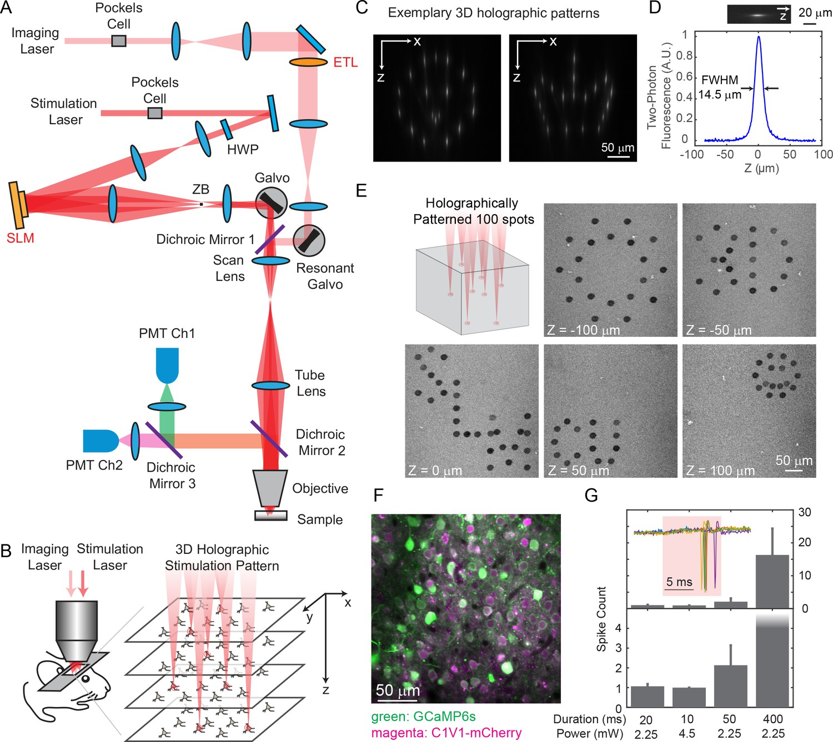
Holographic Imaging and Photo-Stimulation
Spatial Light Modulation (SLM)
Source: https://doi.org/10.7554/eLife.32671

Slide 3
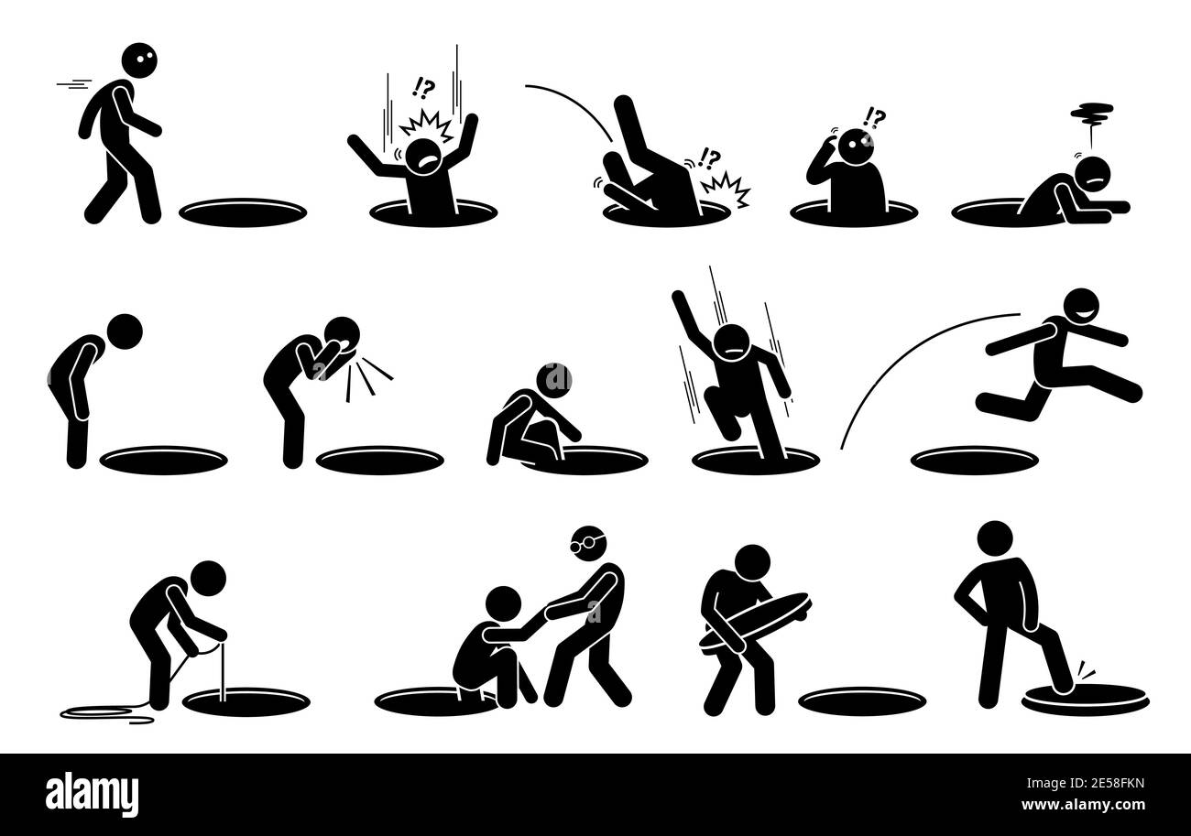
Two Parts of SLM
12/2023-04/2024
Using 2PPlus from Bruker, establish a workflow to stimulate cells assemblies with specific characteristics (functional, or network properties)
Engineering
Spatial Light Modulation (SLM)
04/2024-08/2024
Find the most suitable opto-genetics strategy (cell type interested, animal model, virus, et al)
Biology

Slide 4




Update in Engineering
10-15 mins, Suite2p processing + simple manual correction
To ensure each cell (10 cells/group) has comparable response
Data for analysis
Data for analysis
2p Imaging ~20 min
Quick analysis
2p Imaging + Single cell stimulation ~20 min
Online analysis
Identify the SLM parameters for each single cell
2P imaging + Holographic photo-stimulation
Data for future offline analysis
Bruker_PrairieLink
Bruker_PVLinkExcuteFolder
Bruker_PVLinkExcuteFolder
Identify ROI of each cell, and their behavioral dependency

Slide 5
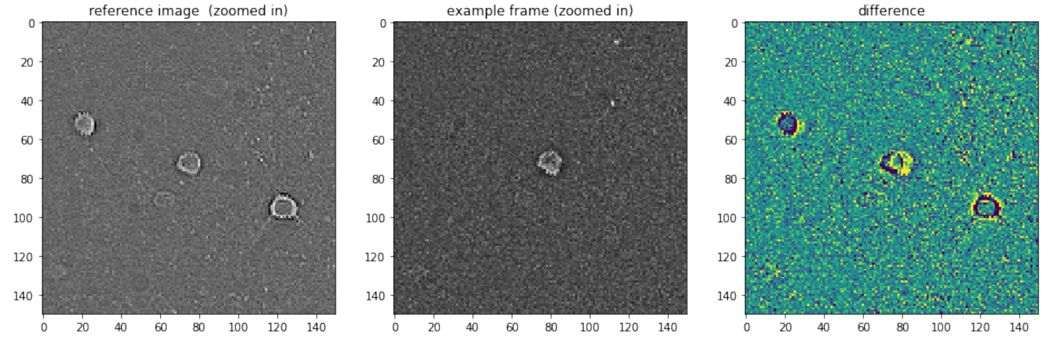
Update in Engineering
To ensure each cell (10 cells/group) has comparable response
Data for analysis
Data for analysis
2p Imaging ~20 min
Quick analysis
2p Imaging + Single cell stimulation ~20 min
Online analysis
Identify the SLM parameters for each single cell
2P imaging + Holographic photo-stimulation
Data for future offline analysis
Bruker_PrairieLink
Bruker_PVLinkExcuteFolder
Bruker_PVLinkExcuteFolder
Online phase off-set checking to ensure recording quality
1st recording file
Current trial
Phase-difference (x, y by pixels)

Slide 6
Update in Engineering
To ensure each cell (10 cells/group) has comparable response
Data for analysis
Data for analysis
2p Imaging ~20 min
Quick analysis
2p Imaging + Single cell stimulation ~20 min
Online analysis
Identify the SLM parameters for each single cell
2P imaging + Holographic photo-stimulation
Data for future offline analysis
Bruker_PrairieLink
Bruker_PVLinkExcuteFolder
Bruker_PVLinkExcuteFolder
Make future single target as 1 target + 9 non-targets
Non-targets: Randomly chosen from regions with blood vessels across 3 recording planes, 30 µm away from all detected cells, 50 µm away between each non-targets.

Slide 7
Two Parts of SLM
Using 2PPlus from Bruker, establish a workflow to stimulate cell assemblies with specific characteristics (function, or network properties)
Engineering
Spatial Light Modulation (SLM)
Find the most suitable opto-genetics strategy (cell type interested, animal model, virus, et al)
Biology

Slide 8
Main Aims in Biology Part of SLM
Cell Targets: Excitatory Cells in Primary Somatosensory Cortex (L2/3)
SLM
High signal quality (Calcium signals)
Large population of cells (Calcium signals)
Aims :
Considerable population of SLM target cells (Opto-genetics)
Low and controllable ‘cross-talk’ issue.
Affordability (Animal, surgery, delay-time)

Slide 9
Evaluation of Three Animal Strategies
 | vGluT1-Ai203 (n = 2) | GCamp6s-CamKII (n = 3) | Emx1.Cre-Ai96 (n = 1)
?
Signal quality
Imaging population
Aims :
?
SLM populations
?
‘Cross-talk’
?
Affordability

Slide 10
Surgery Procedure: GCamp6s-CamKII
Virus: AAV5-TRE-ChroME2f-ST-P2A-NLS-mRuby3
Surgery (Cranial window, virus injection)
#Imaging
CanSensor: GCamp6s
CamKII: True
Calcium imaging, SLM responsive cells found
0 1 2 3 4 5
Time (weeks)
~ 3 weeks waiting time

Slide 11
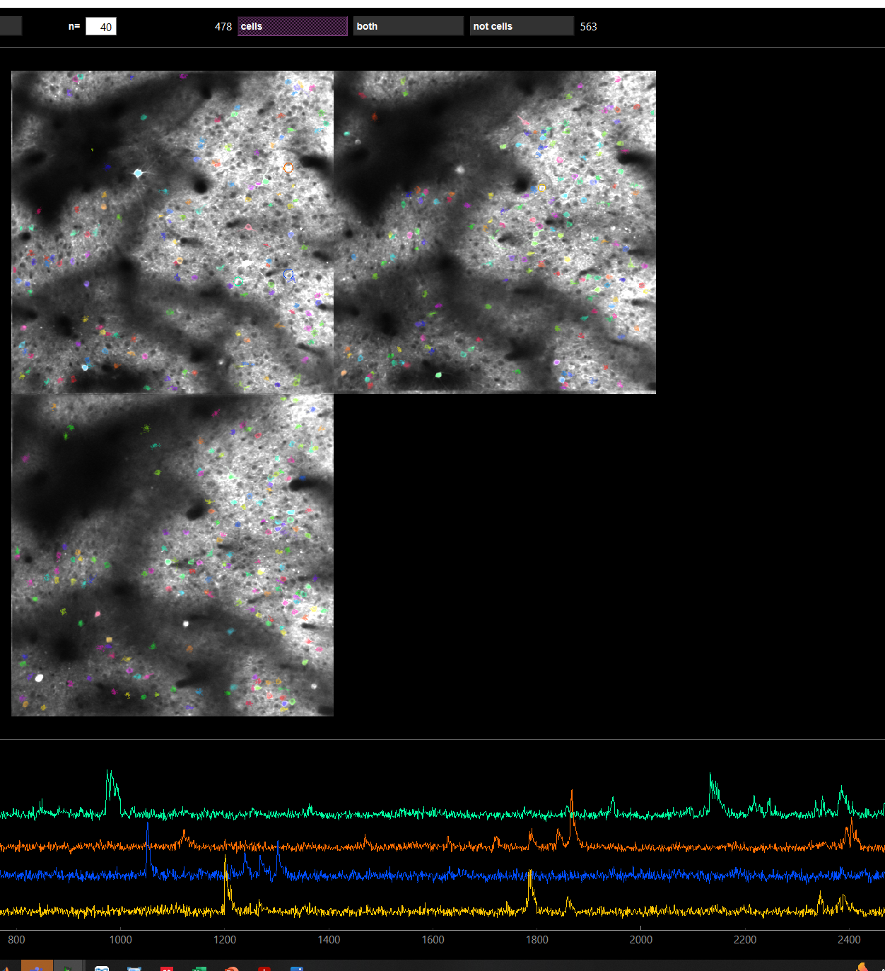
SLM: GCamp6s-CamkII
300-600 cells with 3 planes (697.2 x 697.2 µm) recording
High signal/noise ratio

Slide 12
Observe and Quantify Cross-talk under SLM
Several Hypothesis:
Laser power
Low High
Sham stimuli trial, where SLM power = 0
Almost no cross talk
Strong cross talk
Moderate cross talk
Neural activities
2P Imaging start
Time
Time
Time
2P Imaging start
2P Imaging start
SLM
SLM
SLM

Slide 13
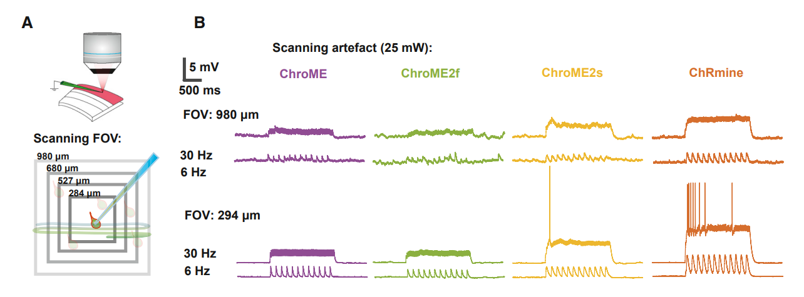
SLM: Cross-talk
“Laser used for 2P imaging of neural activity (e.g., via GCaMP sensors) might incidentally depolarize the neurons of interest through activation of the opsin molecules.”
https://doi.org/10.1016/j.neuron.2022.01.008

Slide 14
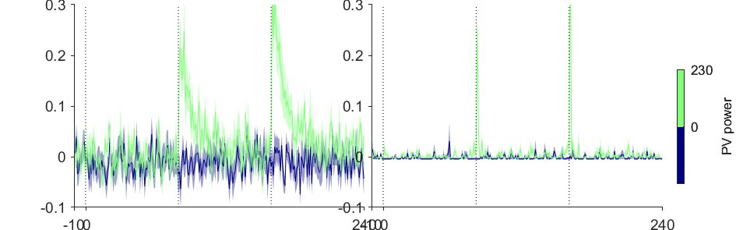
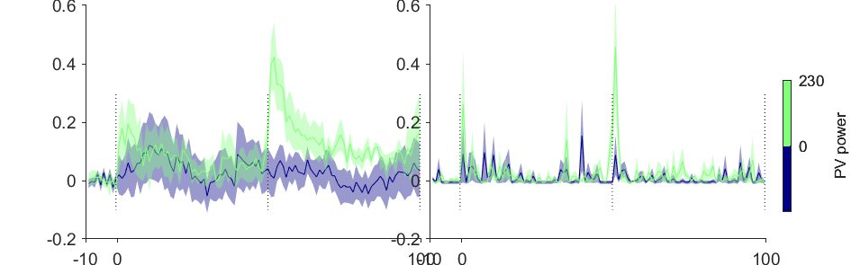
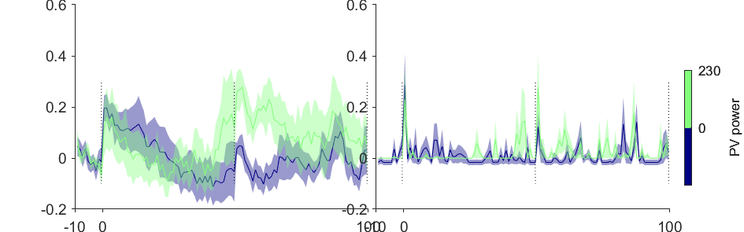
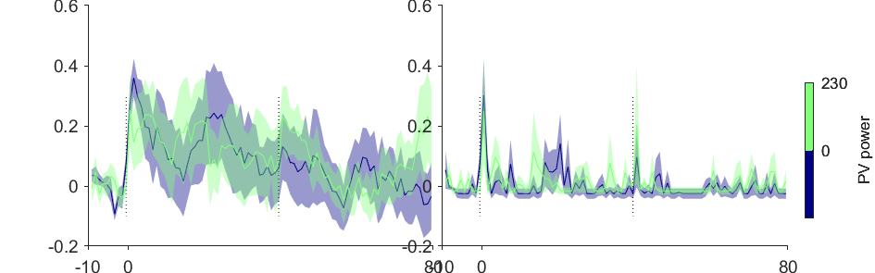
Cross-talk Examples: GCamp6s-CamkII
Unit 1
Stimuli trial, where SLM power > 0
Neural activities
Sham stimuli trial, where SLM power = 0
Unit 2
Unit 3
2P Imaging start
SLM
SLM
Unit 4
2P Imaging start
2P Imaging start
SLM
SLM
2P Imaging start
SLM

Slide 15
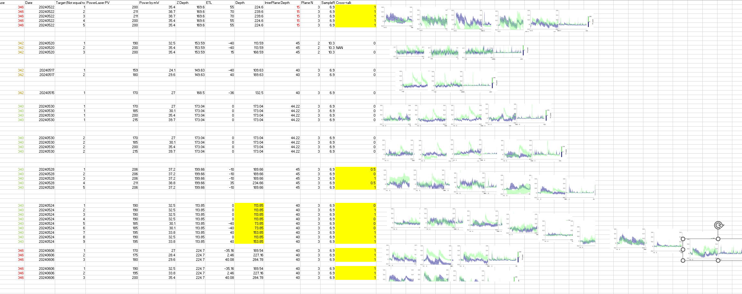
SLM: GCamp6s-CamkII, Cross-talk
Cross-talk of ChroME2f
FOV: 512 x 512 pixels, 697.2 x 697.2 µm, 3 Planes with inter plane > 40 µm
Sampling rate: 6.9 Hz
2P laser scanning power < 30 mW is safe

Slide 16
Limited SLM Targets: GCamp6s-CamkII
Example 2P FOV, Red Channels (mRuby3)
Summary from multiple recording days from 3 mice:
Less than < 8 SLM targets could found across multiple planes within the 697.2 x 697.2 µm, within depth between 80 µm and 240 µm.

Slide 17
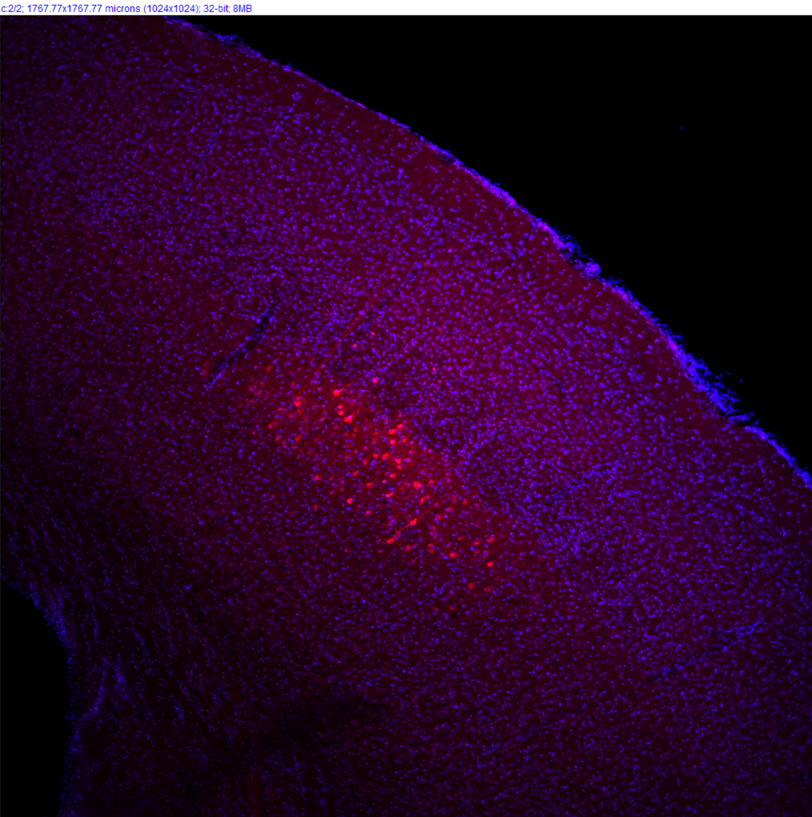
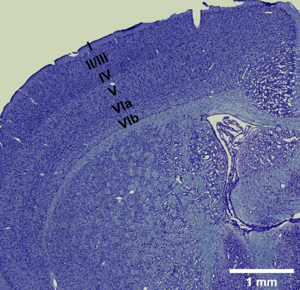
Limited SLM Targets: GCamp6s-CamkII
Example Brain Slice, Red (mRuby3)
Ref by google
2p imaging range
Almost no cells at layer II&III

Slide 18
Evaluation of Three Animal Strategies
 | vGluT1-Ai203 (n = 2) | GCamp6s-CamkII (n = 3) | Emx1.Cre-Ai96 (n = 1)
?
Signal quality
Imaging population
Aims :
?
×
SLM populations
?
?
‘Cross-talk’
?
Affordability
×

Slide 19
Evaluation of Three Animal Strategies
 | vGluT1-Ai203 (n = 2) | GCamp6s-CamkII (n = 3) | Emx1.Cre-Ai96 (n = 1)
?
Signal quality
Imaging population
Aims :
?
×
SLM populations
?
?
‘Cross-talk’
?
Affordability
×

Slide 20
Surgery Procedure: vGluT1-Ai203
Ai203(TITL-sChroME-Kv2.1-GC7s-WPRE-ICL-nls-mRuby3-IRES2-tTA2-WPRE))
#Imaging
CanSensor: GCamp7s
vGluT1: True
Surgery (Cranial window)
Calcium imaging, SLM responsive cells found
0 1 2 3 4 5
Time (weeks)
~ 1 week waiting time (surgery recovery)

Slide 21
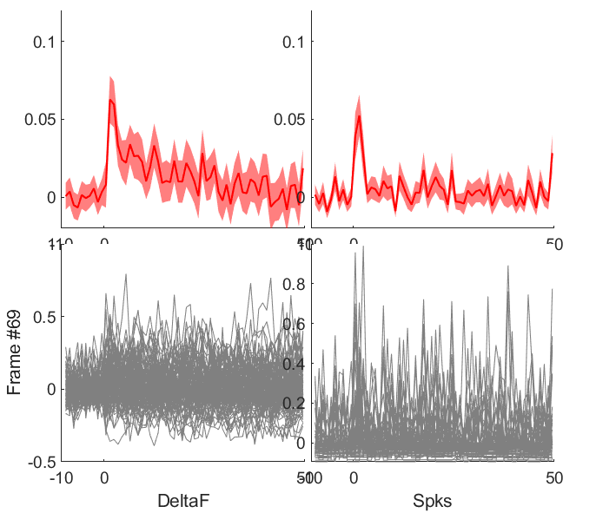
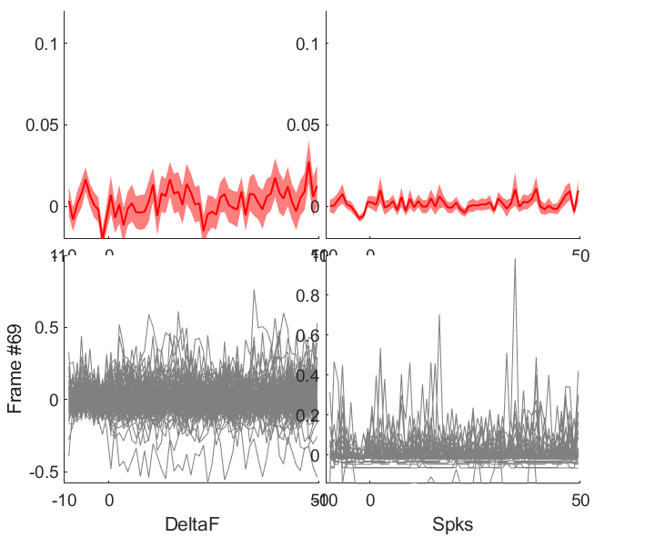
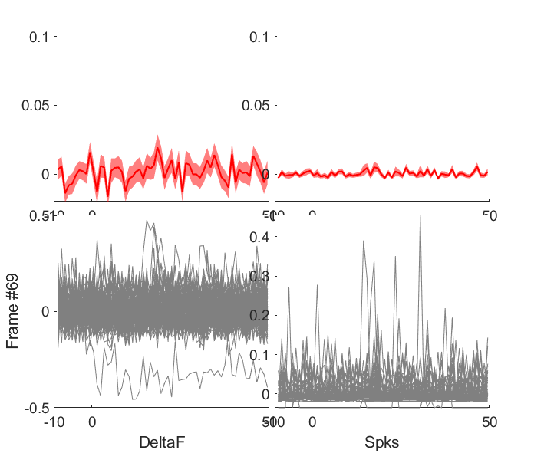
Cross-talk: vGluT1-Ai203
Not comprehensively tested with the cross-talk trial design yet.
Unit 1
Unit 2
Unit 3
There are cross-cell variability. Seems safe for scanning power of 35mW.
2P Imaging start
2P Imaging start
2P Imaging start

Slide 22
Evaluation of Three Animal Strategies
 | vGluT1-Ai203 (n = 2) | GCamp6s-CamkII (n = 3) | Emx1.Cre-Ai96 (n = 1)
?
Signal quality
Imaging population
Aims :
?
SLM populations
?
?
‘Cross-talk’
?
Affordability
√
×

Slide 23
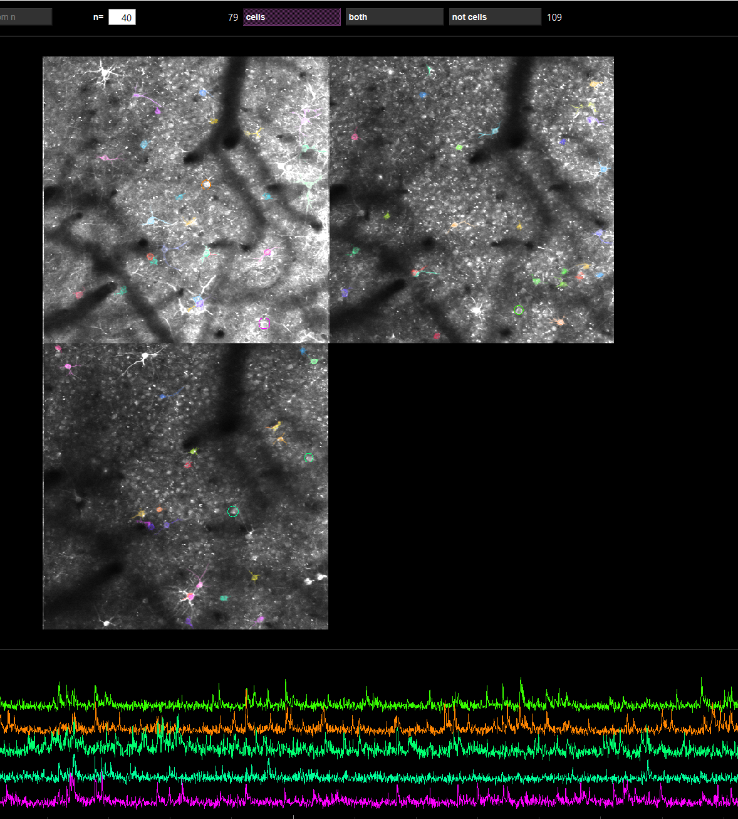
SLM: vGluT1-Ai203
60-120 cells with 3 planes (697.2 x 697.2 µm) recording
Moderate signal/noise ratio
For cells with well detected ROI and signal/noise ratio, SLM in general works.

Slide 24
Evaluation of Three Animal Strategies
 | vGluT1-Ai203 (n = 2) | GCamp6s-CamkII (n = 3) | Emx1.Cre-Ai96 (n = 1)
?
Signal quality
Imaging population
Aims :
?
SLM populations
?
?
‘Cross-talk’
?
Affordability

Slide 25
Surgery Procedure: Emx1.Cre-Ai96
Virus: AAV5-CAG-DIO-ChroME2f-ST-P2A-H2B-mRuby3
Surgery (Cranial window, virus injection)
#Imaging
CanSensor: GCamp6s
Emx1: True
Calcium imaging, SLM responsive cells found
0 1 2 3 4 5
Time (weeks)
> 5 weeks waiting time

Slide 26
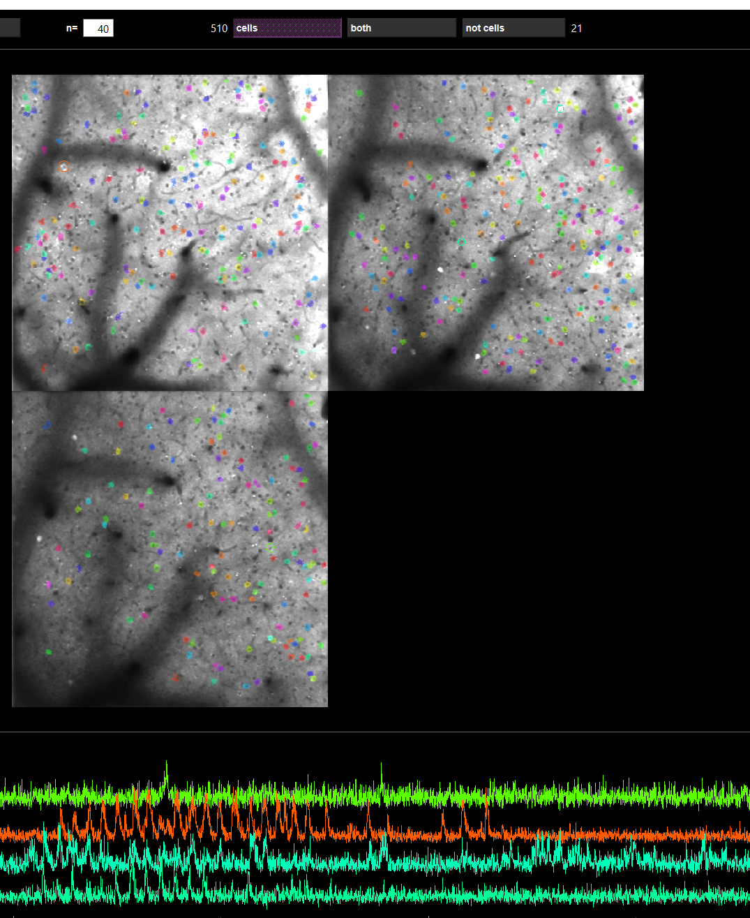
SLM: Emx1.Cre-Ai96
N = 1
200-500 cells with 3 planes (697.2 x 697.2 µm) recording
Moderate signal/noise ratio
Around 2-4 SLM targets could found across multiple planes within the 697.2 x 697.2 µm, within depth between 80 µm and 240 µm, after 5 weeks of surgery.
No responsive SLM targets is found before week 5.

Slide 27
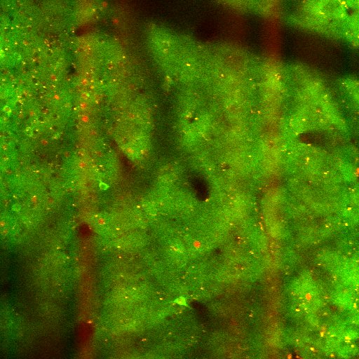
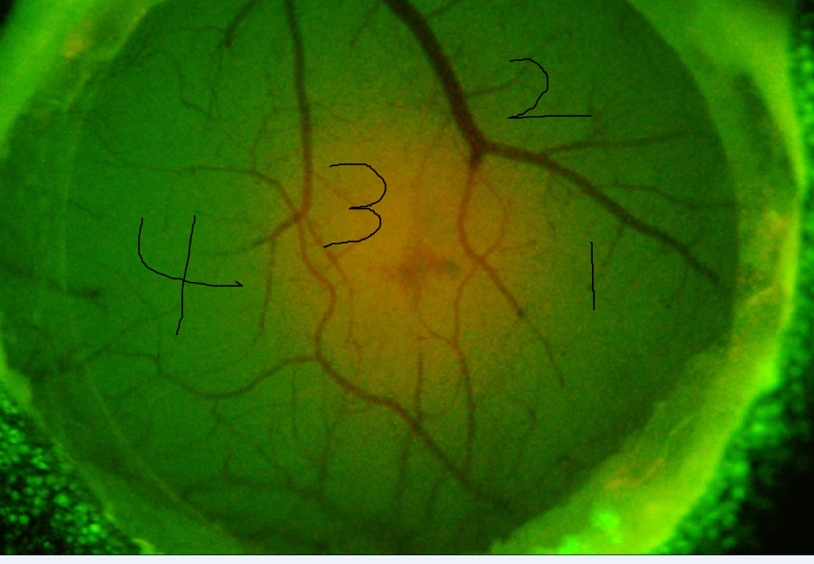
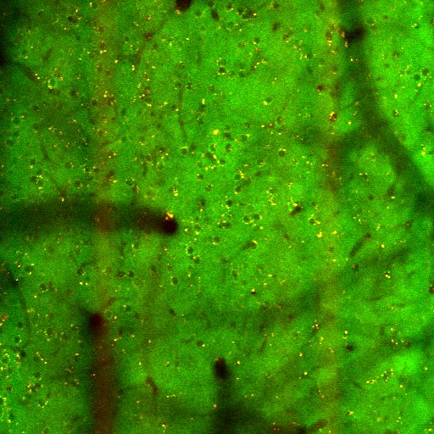
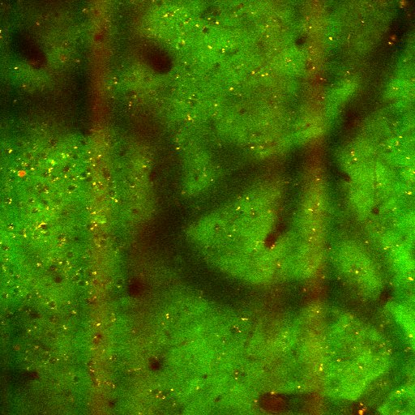
SLM: Emx1.Cre-Ai96
Region 3 (600 frames)
Virus infected regions with low calcium signals observed
Region 4 (600 frames)
Region 2 (600 frames)

Slide 28
Evaluation of Three Animal Strategies
 | vGluT1-Ai203 (n = 2) | GCamp6s-CamkII (n = 3) | Emx1.Cre-Ai96 (n = 1)
?
Signal quality
Imaging population
Aims :
?
×
SLM populations
?
?
‘Cross-talk’
?
Affordability
√
×
Using Ai203 at this moment, while testing more Emx1Cre-Ai96 mice
Move forward with vGluT1-Ai203 , while testing more Emx1Cre-Ai96 mice

